Slide 1
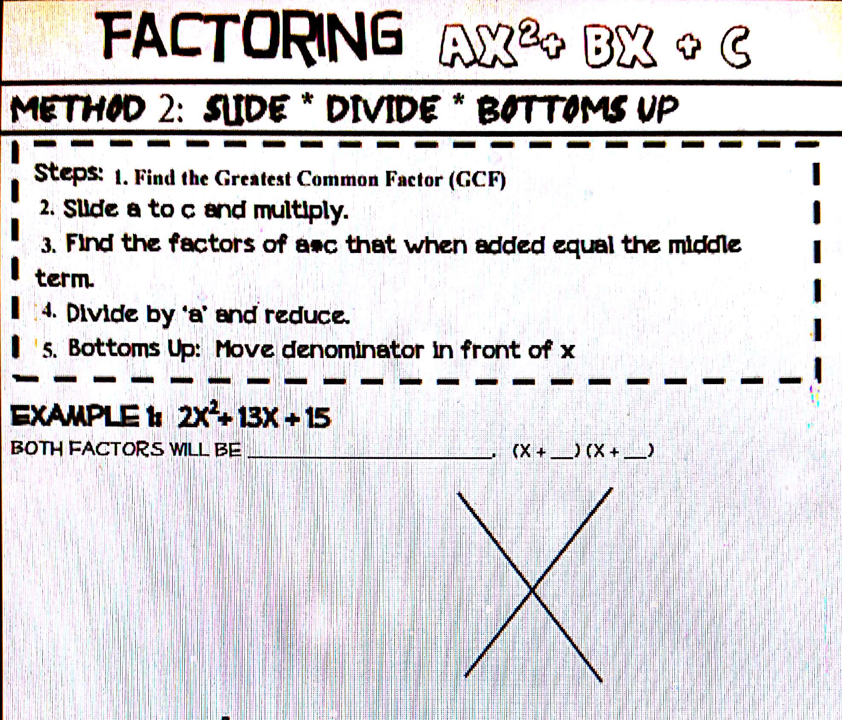
Slide (multiply)
Positive
Factors of 30
1 | 30
2 | 15
3 | 10
5 | 6
X²+13X+30
30
(X+3)(X+10)
3
10
2 2
Divide
Bottoms up
(2X+3)(X+5)
13

Slide 2
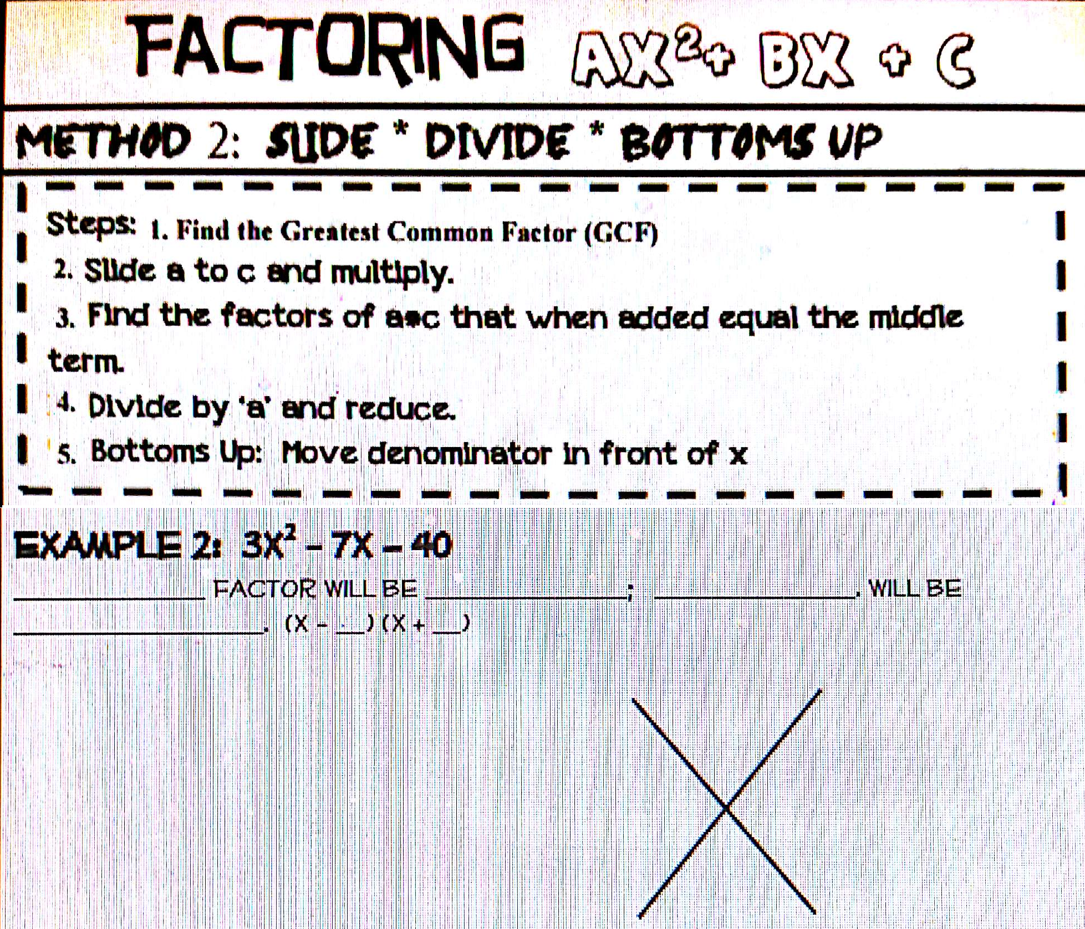
Slide (multiply)
Larger
Negative
Smaller
positive
Factors of -120
2 | -60
4 | -30
5 | -25
8 | -15
10 | -12
X²-7X-120
-120
(X+8)(X-15)
8 -15
Bottoms up
3 3
Divide
(3X+8)(X-5)
-7

Slide 3
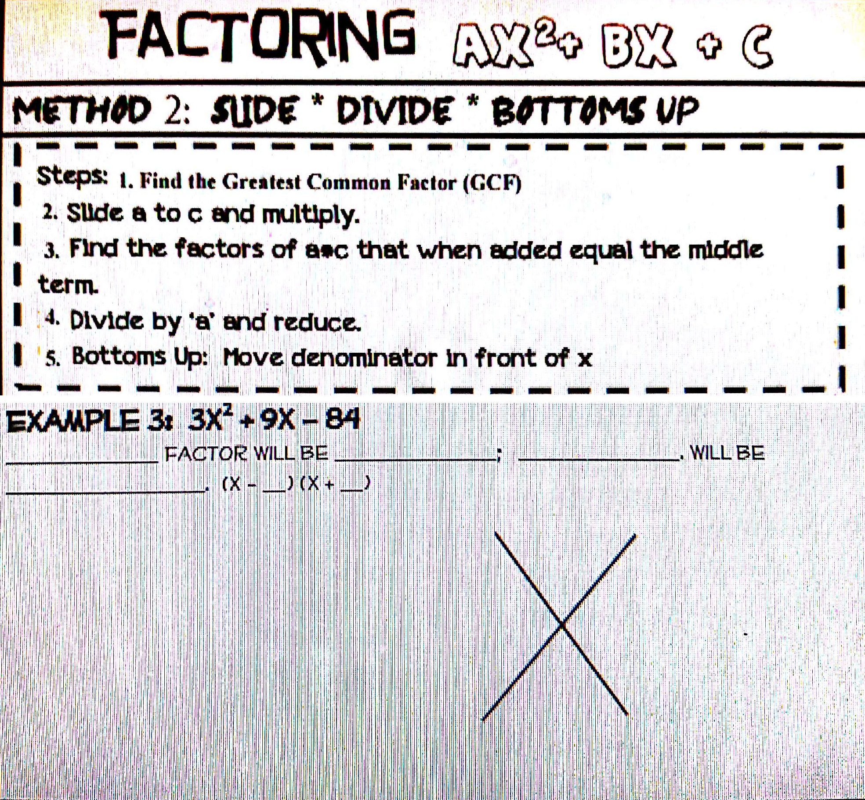
3(1X²+3X-28)
Larger
Positive
Smaller
Negative
3(1X²+3X-28)
-28
Factors of -28
14 | -2
7 | -4
28 | 1
7 -4
3(x+7)(x-4)
3

